Slide 1
The WEIRD problem in a “non-WEIRD” context: A meta-research on the representativeness of human subjects in Chinese psychological research
Lei Yue, Weiwei Zhang, Chunxiao Wang, Xi-Nian Zuo, Hu Chuan-Peng
Corresponding author: Hu Chuan-Peng, hcp4715@hotmail.com

Slide 2
Introduction
Method
Content
Preliminary results
Conclusion & Suggestion

Slide 3
01
Introduction

Slide 4
Research background
Psychological science aims at understanding human mind and behaviour. However, psychological science largely relies on unrepresentative human samples: most human participants in published psychological studies are undergraduate students who take psychology courses from “Western, Educated, Industrialized, Rich, and Democratic” regions (Henrich et al., 2010a; Henrich et al., 2010b; Henry, 2008; Sears, 1986)
WEIRD
华中师范大学研究生会

Slide 5
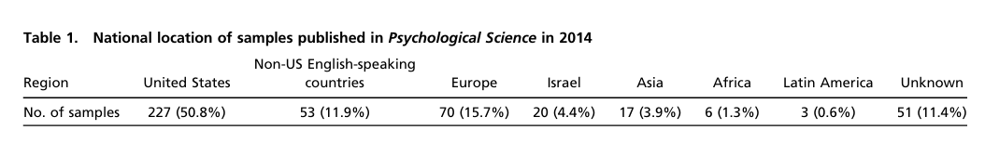
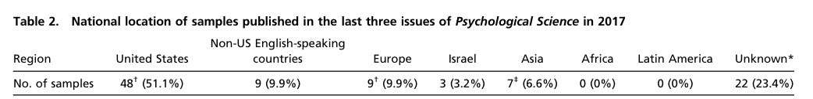
Research background
Rad et al. 2018 PNAS
华中师范大学研究生会

Slide 6
Research background
Note: This figure is compiled from Rad et al. 2018 and 2022 world population data.
华中师范大学研究生会

Slide 7
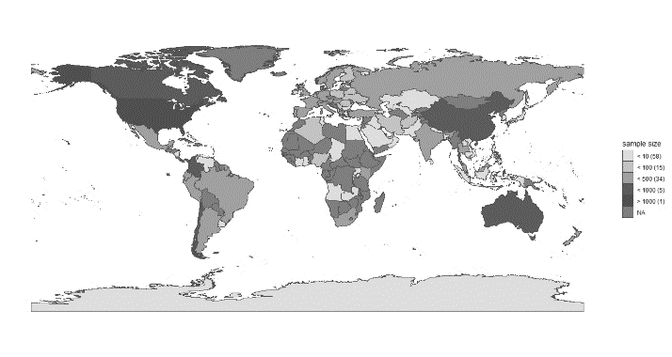
？
Representativeness？
International collaborations projects
PSA
Human Penguin Project
Non_WEIRD data
Asia, Middle East,
Latin America, and Africa
华中师范大学研究生会

Slide 8
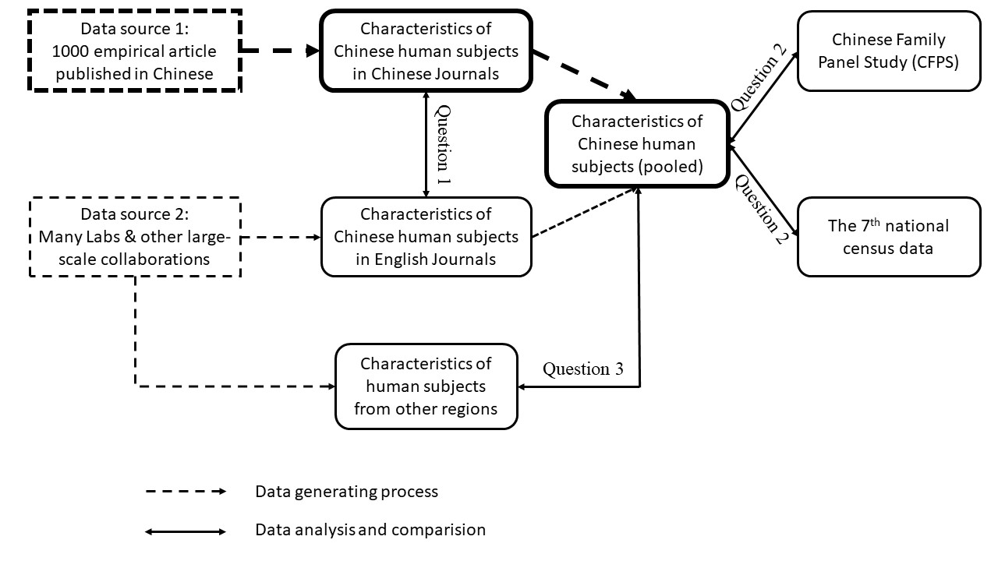
Question 1: Whether characteristics of Chinese subjects reported in large-scale international collaboration are similar to those reported in Chinese psychological journals, given they have the same target population;
Question 2: To what extent the Chinese subjects in psychological science can represent their target population, e.g., the whole population of census data from the National Bureau of Statistics of China and from a large-scale social survey, Chinese Family Panel Study (CFPS);
Question3: What are the shared and distinct patterns of Chinese subjects and subjects from other regions?
华中师范大学研究生会

Slide 9
02
Method

Slide 10
中国临床心理学
gender,
age,
SES etc.
心理学报
心理与行为研究
心理科学
心理发展与教育
1,000 empirical research papers
...
five mainstream Chinese journals
Data source
31 projetcs
Authors’ raw data.
International collaborations projects
华中师范大学研究生会

Slide 11

data process, analysis and visualization
Bayes factor (Bayesian multinomial test)
华中师范大学研究生会

Slide 12
03
Preliminary results

Slide 13
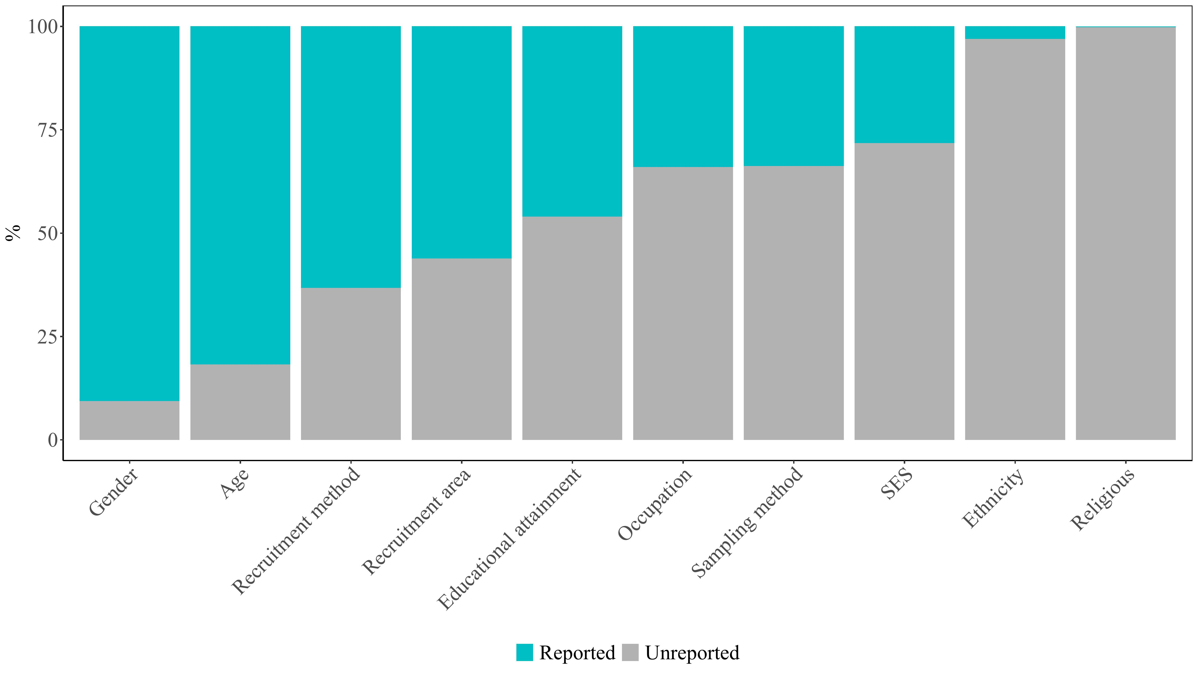
Q2
华中师范大学研究生会

Slide 14
Research background
Question 1: Whether characteristics of Chinese subjects reported in large-scale international collaboration are similar to those reported in Chinese psychological journals, given they have the same target population;
华中师范大学研究生会

Slide 15
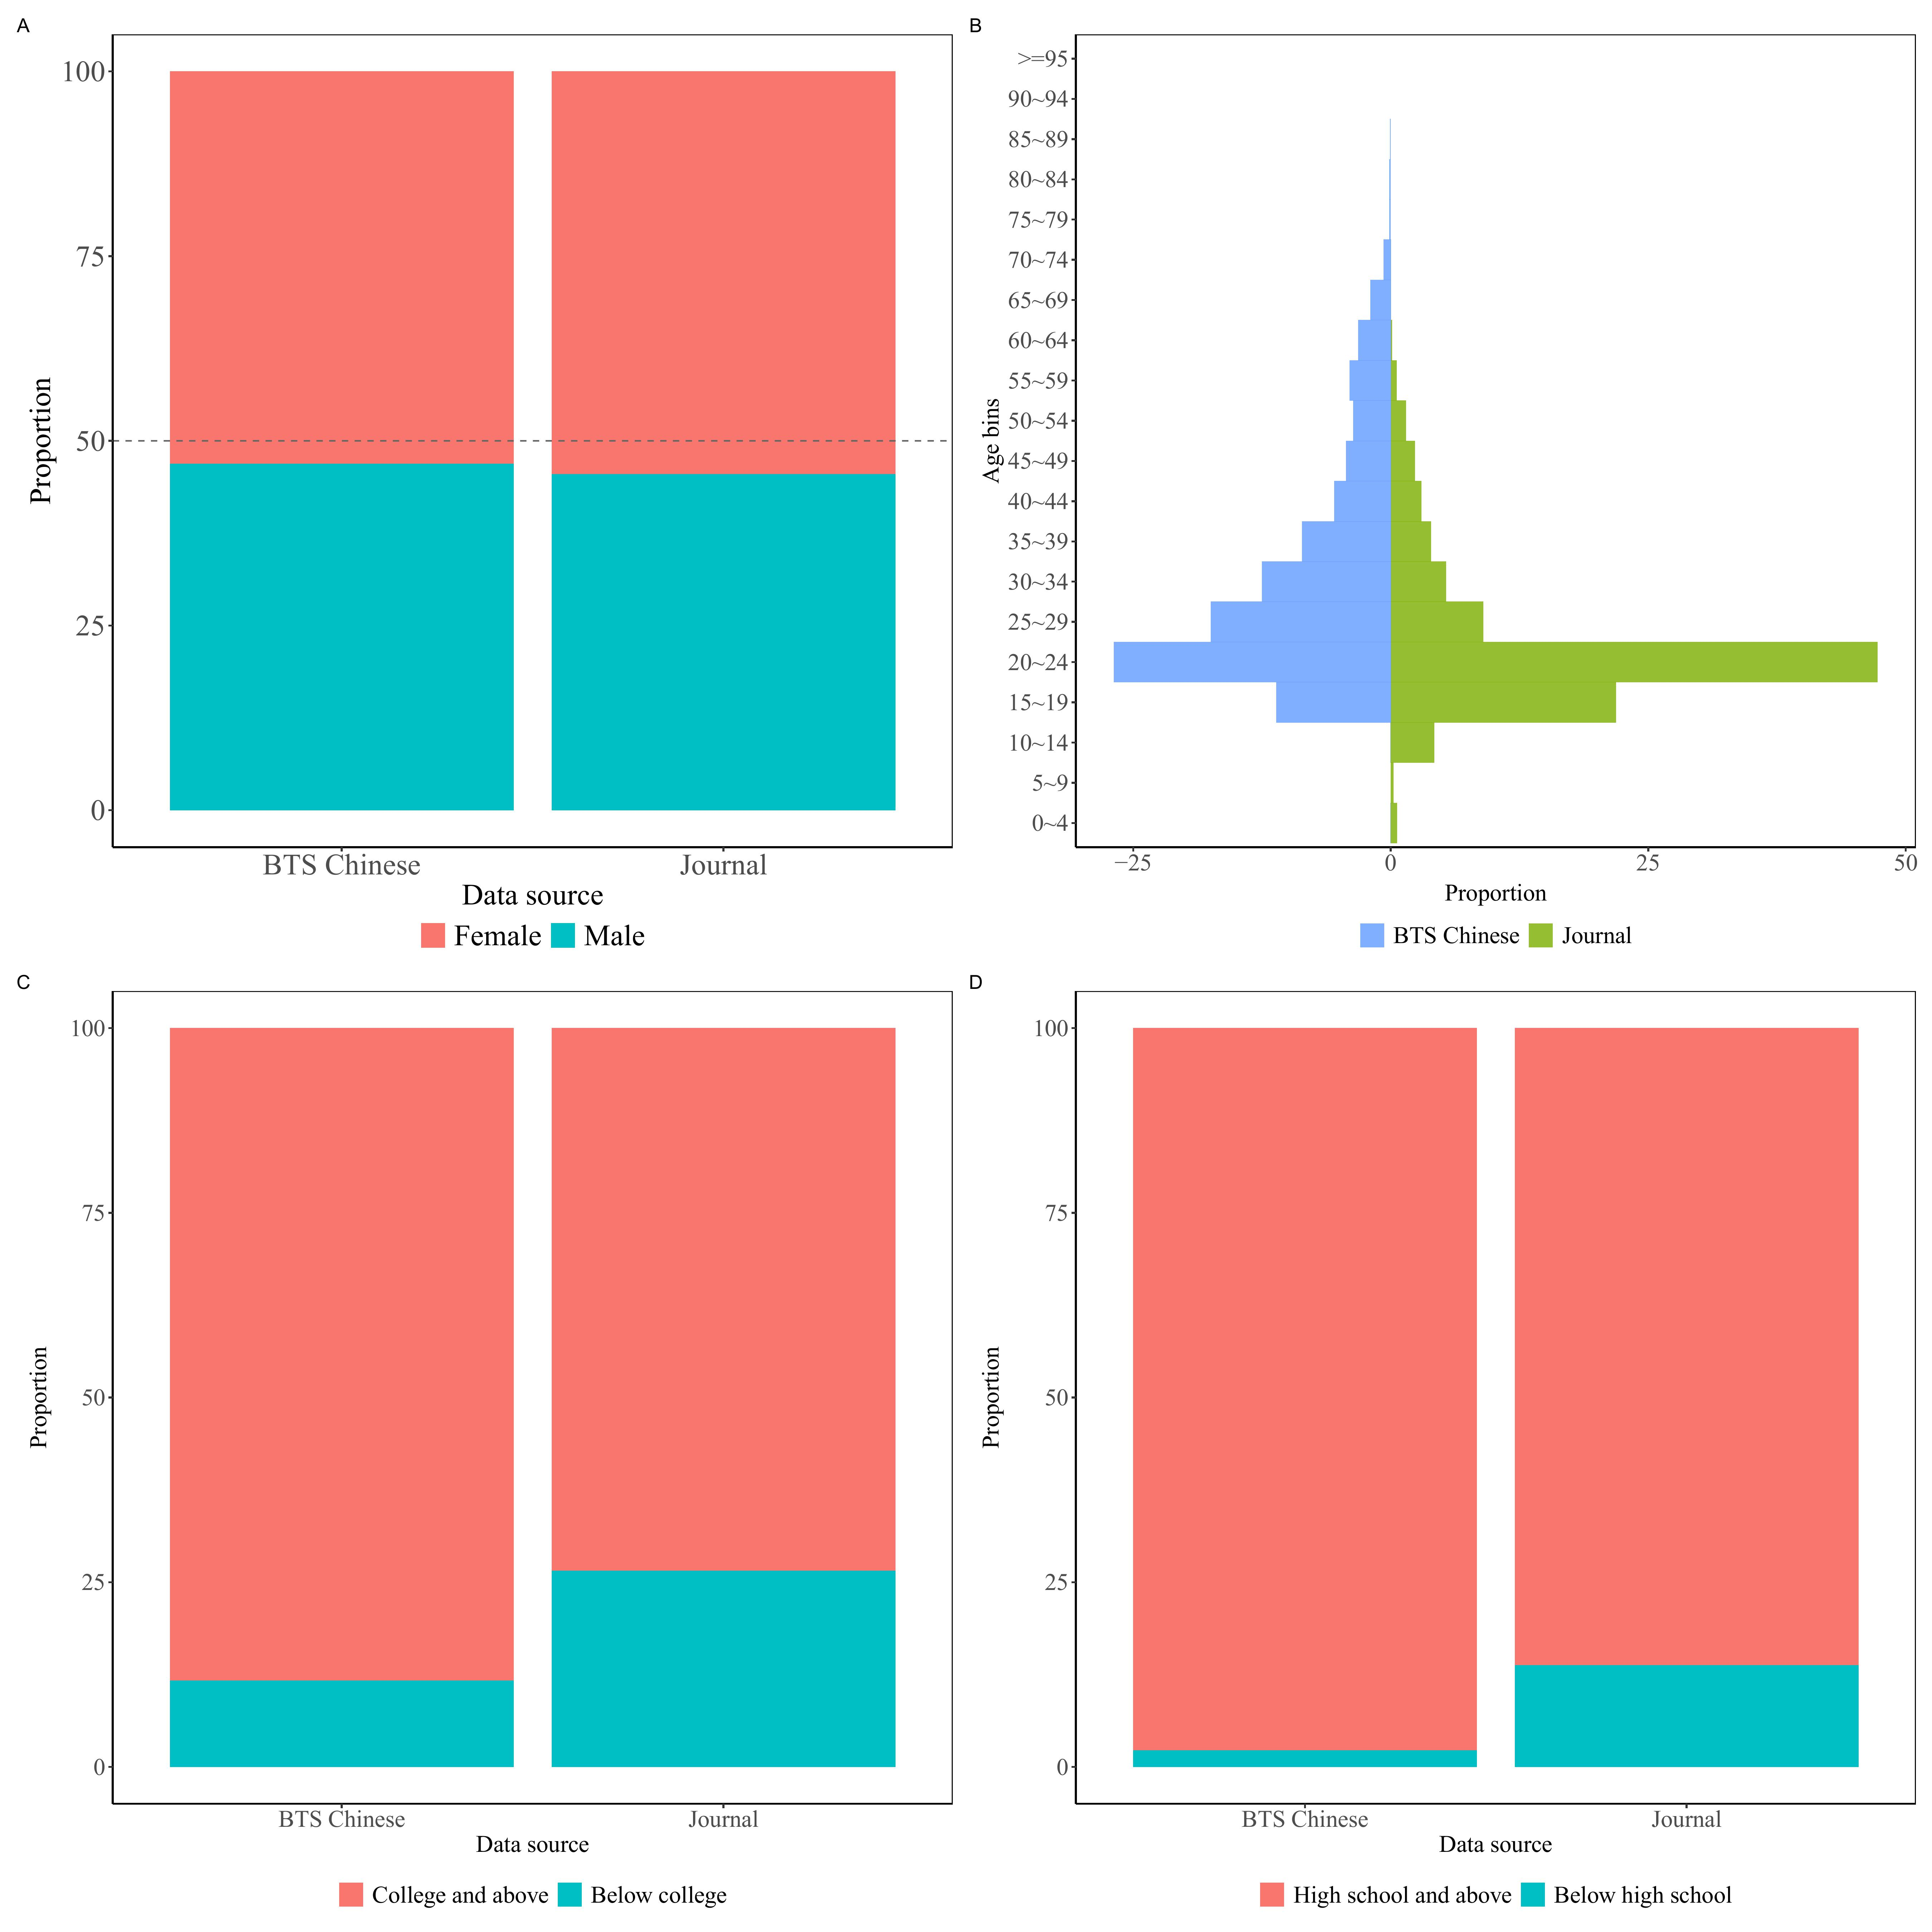
Q2
Gender: moderate evidence supporting H₀, log(BF₁₀) = -2.05 (see left figA).
Age: extremely strong evidence supporting H₁, log(BF10) = 41.37 (see left figB). Samples peak at 20~24 years old).
Educational attainment: evidence supporting H₁, College vs < College: log(BF₁₀) = 1.14, see left FigC; high school vs < high school: log(BF₁₀) = 2.91, see see left figD
华中师范大学研究生会

Slide 16
Research background
Question 2: To what extent the Chinese subjects in psychological science can represent their target population, e.g., the whole population of census data from the National Bureau of Statistics of China and from a large-scale social survey, Chinese Family Panel Study (CFPS);
华中师范大学研究生会

Slide 17
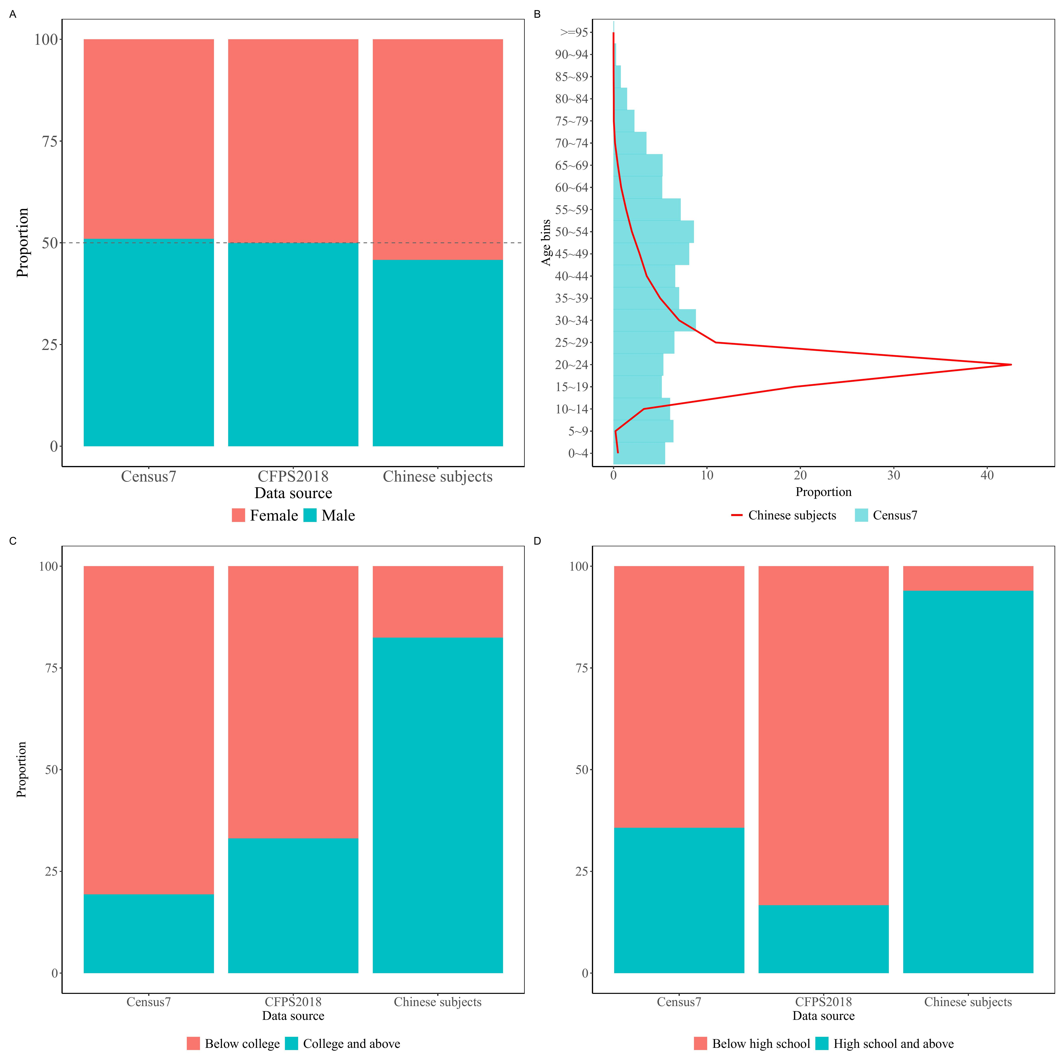
Q2
The differences lie in age and educational level. ased on the first two research questions, it is not difficult to see that the Chinese participants in psychology studies exhibit the characteristic "Educated."
华中师范大学研究生会

Slide 18
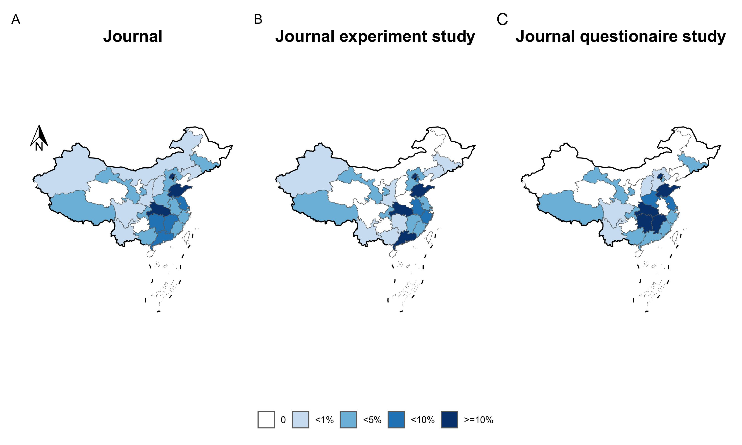
Q2
These are what we might call the “Educated and Rich” regions, similar to the WEIRD population in psychology research
华中师范大学研究生会

Slide 19
Research background
Question3: What are the shared and distinct patterns of Chinese subjects and subjects from other regions?
华中师范大学研究生会

Slide 20
Q2
24 countries had different gender ratios compared to Chinese psychological samples.
28 countries showed a higher proportion of female subjects than Chinese samples
华中师范大学研究生会

Slide 21
Q2
2 countries had different age ratios compared to Chinese psychological samples.
17 countries and regions showed a higher proportion of subjects in 18~25 age bracket than Chinese samples
华中师范大学研究生会

Slide 22
04
Conclution & Suggestion

Slide 23
Research background
(1) Consistent with Rad et al. (2018), gender and age are the most frequently reported;
(2) The Chinese psychological samples exhibit the “Educated” characteristics across the two data sources;
(3) Compared with China’ 7th Census data, age and educational attainment differ from Census figures;
(4) Notably, other regions shared a similar pattern to those of Chinese participants in psychological research.
华中师范大学研究生会

Slide 24
Research background
(1) First, standardize reporting protocols for participant information;
(2) Second, sustain the implementation of large-scale international collaborative projects;
(3) Finally, optimize participant recruitment strategies and sampling methods.
华中师范大学研究生会

Slide 25
Thanks!
Thanks!

